Slide 1
Hypervisor Integrity Protection
HyperCheck: A Hardware-Assisted Integrity Monitor

Slide 2
目录
1
What is Hypervisor Integrity Protection?
CONTENTS

Slide 3
1
What is Hypervisor Integrity Protection?
目录
CONTENTS
2
Background

Slide 4
1
What is Hypervisor Integrity Protection?
目录
2
Background
CONTENTS
3
What is HyperCheck?

Slide 5
What is Hypervisor Integrity Protection?
01

Slide 6
What is Hypervisor Integrity Protection
Integrity is the ability to protect the transmission, reception or storage of information is complete and has not been tampered with, it is one of the important attributes of information security.
There have been some relevant studies on integrity protection
File integrity protection
Periodic file protection：Tripwire,AIDE,Samhain etc.
Real-time file protection：Based on the Xen virtual machine
Kernel code integrity protection
Copilot,secVisor etc.
Virtual Machine Manager code integrity protection
HyperSafe,HyperSentry,HyperCheck etc.

Slide 7
Background
02

Slide 8
Background
The advent of cloud computing and inexpensive multi-core desktop architectures has led to the widespread adoption of virtualization technologies.
Hypervisors are increasingly used as components to enforce system security and resilience. Due to their widespread adoption, hypervisors have attracted the attention of attackers.
To address some limitations and to complement the existing protection mechanisms.

Slide 9
What is HyperCheck?
03

Slide 10
The basic principles of HyperCheck
HyperCheck is a hardware-assisted tampering detection framework to protect the integrity of hypervisors or operating systems.
HyperCheck harnesses the CPU System Management Mode (SMM) present in all x86 commodity systems to create a snapshot view of the current states of the CPU and memory of the protected machine.
This information is securely transmitted using a network card to a remote monitor machine. Then, the monitor machine can identify any tampering by comparing the newly generated snapshot with the one recorded when the machine was initialized. If the two views do not match, a human operator is notiﬁed for further investigation.

Slide 11
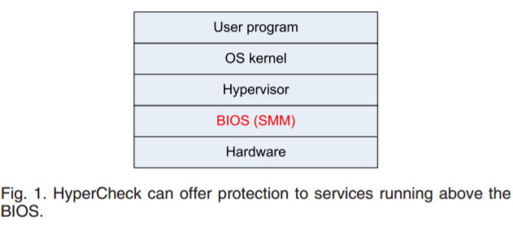
The basic principles of HyperCheck
As shown in Fig. 1, HyperCheck works at the Basic Input-Output System (BIOS) level and can protect the software above.

Slide 12
System Management Mode and BIOS
System Management Mode is a separate CPU mode from the protected mode and real mode.
It provides a transparent mechanism for implementing system-control functions.
SMM is implemented by the Basic Input-Output System.
BIOS is an indispensable component for all computers.
The main function of the BIOS is to initialize the hardware devices, including main memory, hard disk etc.
BIOS code is normally stored on a non-volatile ROM chip on the motherboard.

Slide 13
The components of HyperCheck Framework
HyperCheck is composed of three key components
the physical memory acquisition module
the analysis module
the CPU register checking module
Both the physical memory acquisition module and CPU register checking module are on the target machine, and the analysis module is on the monitor machine.

Slide 14
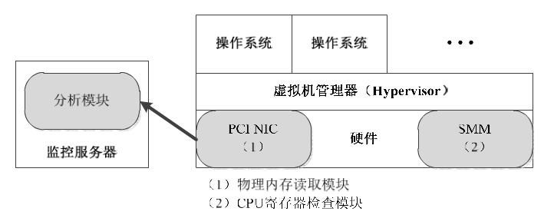
The architecture of HyperCheck
The memory acquisition module reads the memory contents of the protected machine and sends it to the analysis module, which then checks the memory contents for any malicious alterations. The CPU register checking module reads the CPU registers and validates their values.
The architecture of HyperCheck

Slide 15
The Design Principle of HyperCheck
The main design principle is that HyperCheck should not rely on any software running on the machine except the BIOS.
Because SMM code resides in the BIOS, the BIOS and the monitor machine should be the only Trusted Computing Base (TCB) in our system.
Therefore, we could use SMM to read the CPU registers and memory contents, and then use a PCI Ethernet card to send out this information to the monitor machine.

Slide 16
HyperCheck-I vs HyperCheck-II
To evaluate the security and performance of our framework, we implement two prototypes of HyperCheck framework.
original closed source BIOS
It relies on an unlocked SMRAM to inject the customized SMI handler code
the high development complexity
an open-source BIOS
provide an unlocked SMRAM for us to add customized SMI handler code.
we can directly modify the BIOS code on the target machine

Slide 17
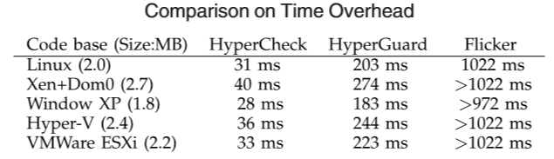
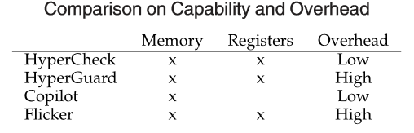
Comparison with Other Methods
TABLE 1
TABLE 2

